Slide 1
General Tree to Binary Tree

Slide 2
Steps to Convert General Tree to Binary Tree
All the nodes of the General Tree will be the nodes of Binary Tree
Root of the General Tree be the Root of Binary Tree
Find the branch Parent to Leftmost Child
Connect Siblings of each node Left to Right child
Delete all the link from node to its children

Slide 3
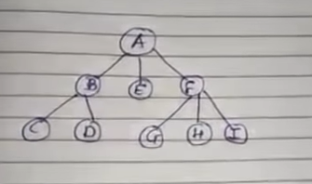

Slide 4
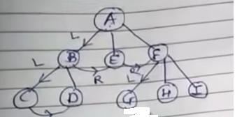

Slide 5
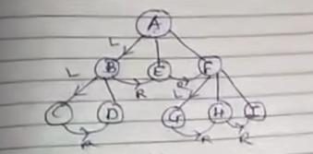

Slide 6
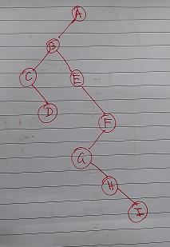

Slide 7
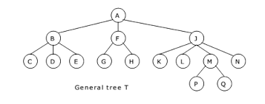
Home work

Slide 8
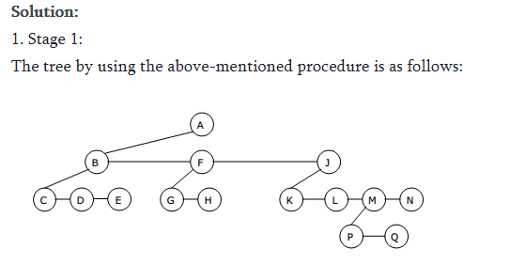

Slide 9
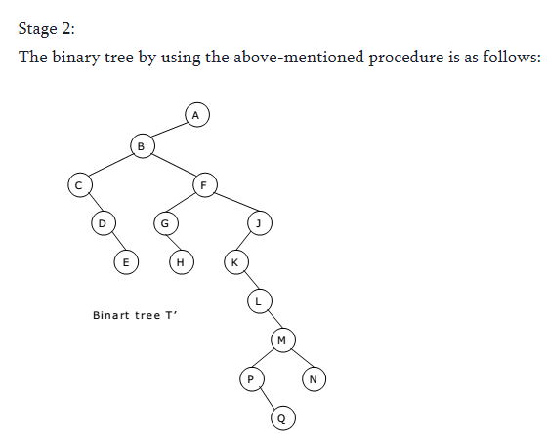

Slide 10
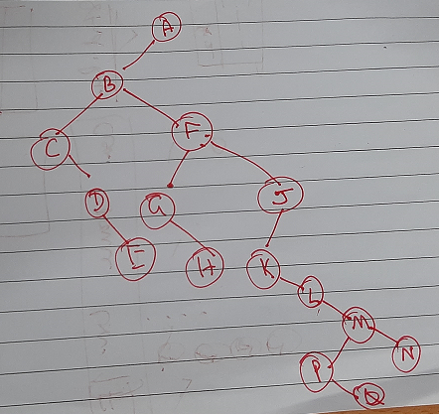

Slide 11
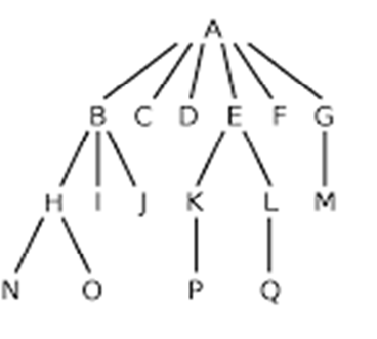

Slide 12
